Slide 1
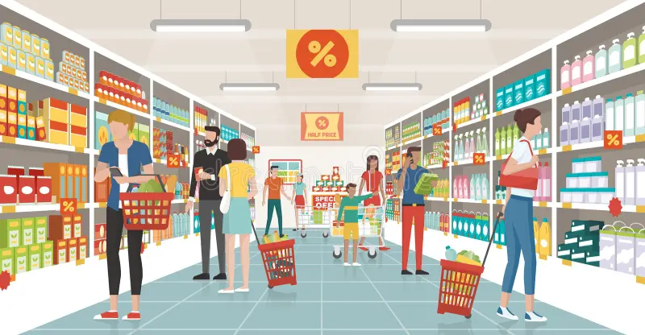
Presented By
Lamia Afrin Zaman
1909020

Slide 2
Introduction
Project Features:
Creation of E-R diagram and schema diagram
Use of SQL to create tables for storing info
Use of PL/SQL
to automatically increase product quantity when the supplier supplies products, decrease when a customer buys products
When the product quantity falls below a certain amount, the database will generate a product quantity status automatically to alert the employees
To find out the total price and grand total price automatically when the billing transactions are being invoked
Prevent anomalies
The super shop management system is where all the aspects related to proper management of the super shop are done.
It comprises various interconnected components such as product management, employee management, customer management, supplier management, order processing etc to streamline super shop operations.
This project aims to create an efficient database for storing and processing all the information regarding super shop management

Slide 3
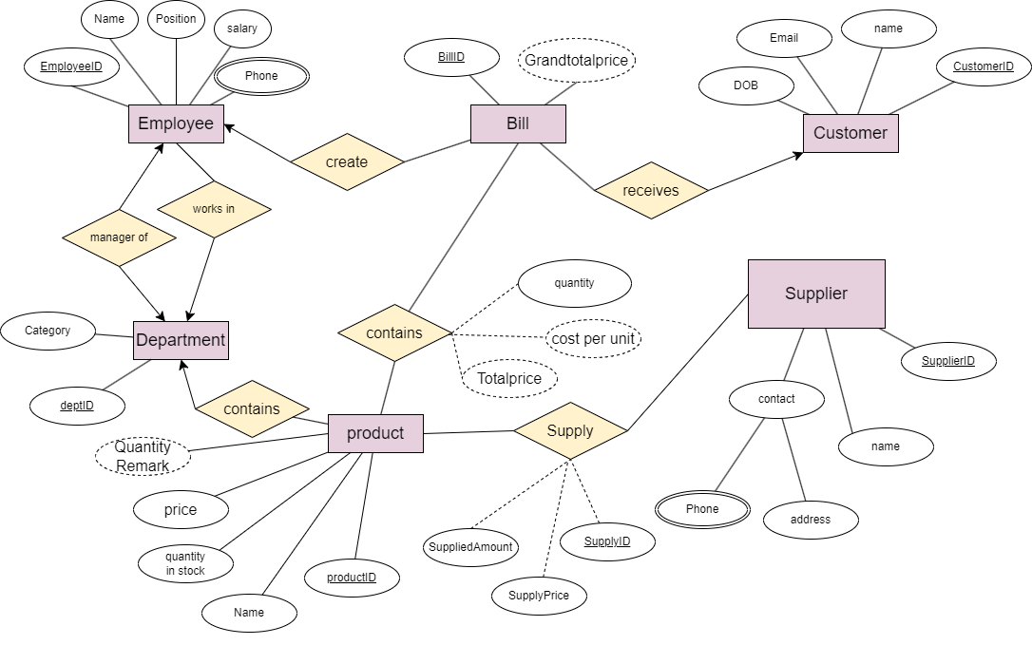
E-R Diagram

Slide 4
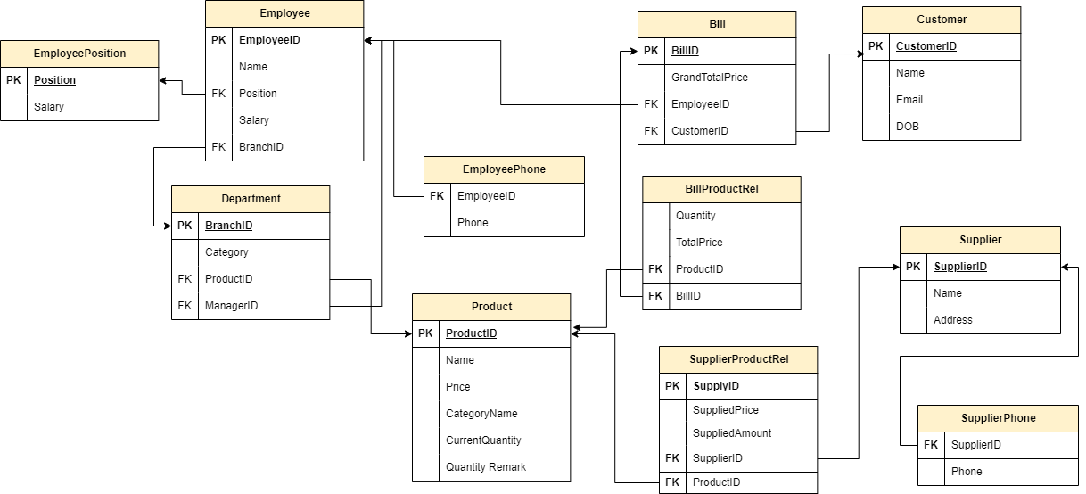
Schema Diagram
So due to multivalued attributes and relationship between attributes, there are eleven decomposed tables which prevent anomalies and redundancies

Slide 5
Department Table
DeptID | Category Name | ManagerID
1 | Dairy | 1001
2 | Clothing | 1003
3 | Cosmetics
4 | Grocery

Slide 6
EmployeePosition Table
Position | Salary
Manager | 20000
Cashier | 15000
Stock Clerk | 2000
Cleaner | 1000

Slide 7
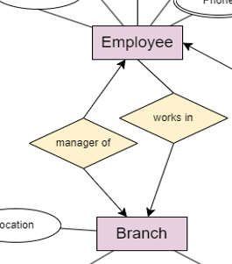
Employee Table
EmployeeID | Name | Position | BranchID
1001 | A | Manager | 1
1002 | B | Cashier | 1
1003 | C | Manager | 2
1004 | D | Cashier | 2
1005 | E | Cleaner | 1

Slide 8
EmployeePhone table
EmployeeID | Phone
1001 | 111111
1001 | 111112
1001 | 111113
1002 | 331111
1003 | 114411
1003 | 115761
1005 | 341111

Slide 9
Supplier Table
SupplierID | Name | Address
5001 | X | Gollamari
5002 | Y | Daulatpur
5003 | Z | Moylapota

Slide 10
SupplierPhone table
SupplierID | Phone
5001 | 555555
5002 | 666666
5003 | 777777
5002 | 888888

Slide 11
Product Table
ProductID | Name | Price | DeptID | Current Quantity | Quantity Remark
1 | Milk | 60 | 1 | 7 | Low
2 | Kurti | 300 | 2 | 8 | Low
3 | Egg | 15 | 1 | 2 | Low
4 | Kajal | 100 | 3 | 0 | Low
5 | Rice | 80 | 4 | 10 | Okay
6 | Panjabi | 500 | 2 | 10 | Okay
7 | Saree | 5000 | 2 | 20 | Okay

Slide 12
SupplierProductRel table
SupplyId | SupplyPrice | Supplied Amount | SupplierID | ProductID
1 | 50 | 100 | 5001 | 1
2 | 5 | 200 | 5002 | 3
3 | 40 | 200 | 5002 | 1
This table stores the information about the supplied products and their quantity, price
and also stores information about which supplier supplied which products.

Slide 13
Customer Table
CustomerID | Name | DOB | Email
6001 | AA | 2000-01-01 | a@gmail.com
6002 | BB | 2000-05-04 | b@gmail.com
6003 | CC | 1999-01-01 | c@gmail.com
6004 | DD | 1998-01-05 | d@gmail.com
6005 | EE | 1959-02-02 | e@gmail.com

Slide 14
Bill Table
Bill ID | Total Grand Price | EmployeeID | CustomerID
1 | 170 | 1002 | 6001
2 | 60 | 1004 | 6002
3 | 60 | 1004 | 6003
4 | 60 | 1002 | 6004
5 | 120 | 1004 | 6002
Which employee made the bill for which customer, is stored in the table. That bill contains some products, and the grand total price of those products are also stored.

Slide 15
BillProductRel Table
Bill ID | Product ID | Cost | Quantity bought | Total Price
1 | 1 | 60 | 1 | 60
1 | 3 | 15 | 2 | 30
1 | 5 | 80 | 1 | 80
2 | 1 | 60 | 1 | 60
3 | 1 | 60 | 1 | 60
4 | 1 | 60 | 1 | 60
5 | 1 | 60 | 2 | 120
This table is much similar to product invoice slip. Here for each bill issued by a cashier for a customer, the products of that bill are listed with the information of cost, product ID, quantity bought, total price

Slide 16
NOW, Lets Check Some Interesting Examples on SQL which are frequently used in management of supershops

Slide 17
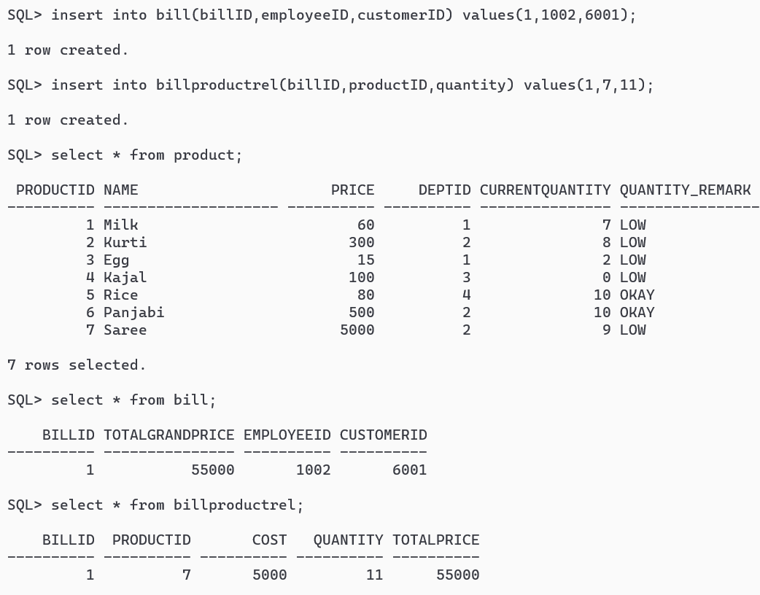
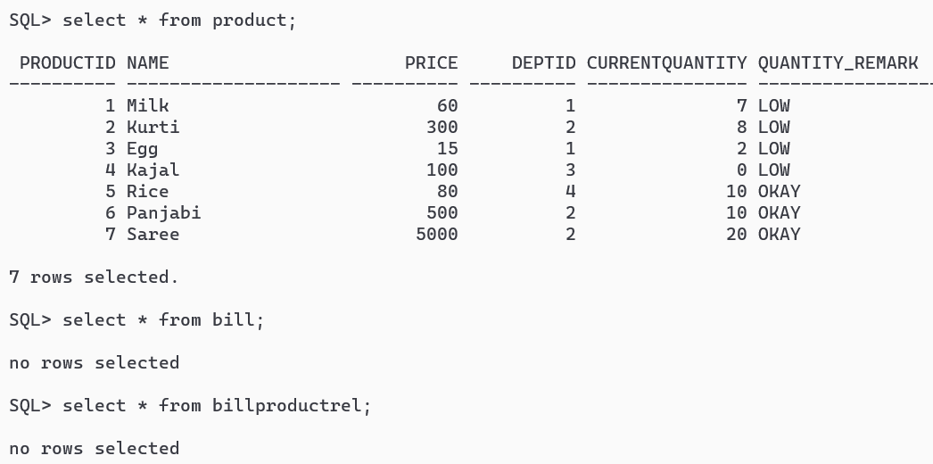
SQL-1
What happens if a customer buys a product?

Slide 18
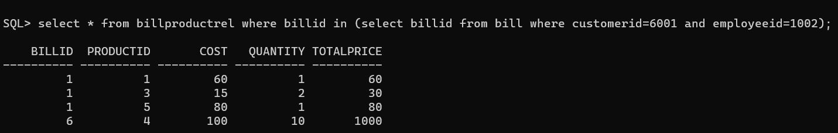
SQL-2
Find out the invoice of all products that was dispatched by employeeID=1002 to customerID= 6001

Slide 19
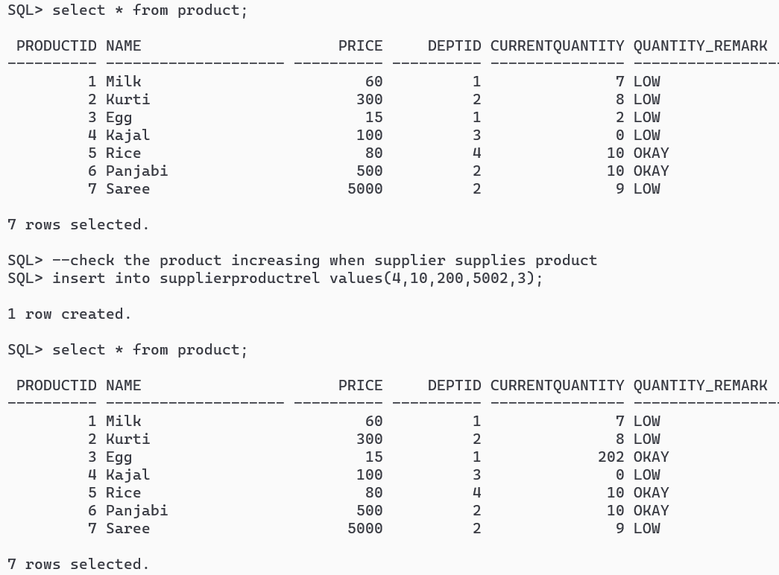
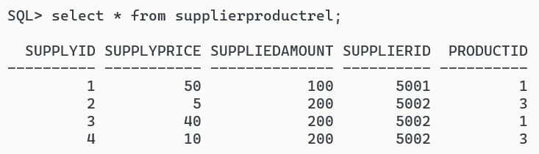
SQL-3: what happens if supplier supplies product?

Slide 20
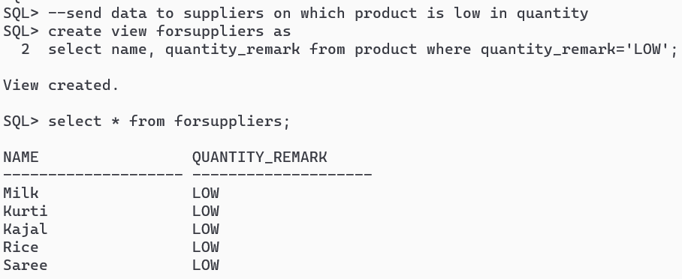
SQL-4: Send selected data to suppliers

Slide 21


